Slide 1
Compiler Optimized Dynamic Taint Analysis
James Kasten
Alex Crowell

Slide 2
Taint Analysis
Taint Analysis
Used to track flow of data through program
Security Applications:
Malware Analysis
Finding Unknown Vulnerabilities
Static
Proves whether it is possible for taint to reach
Dynamic
Track flow dynamically through single execution
Notes:
Alex

Slide 3
Dynamic Taint Analysis
Taint Policies
Taint Rules specify three things
Sources of taint
Sinks of taint
How taint spreads for different instructions
OR based policy is simplest
C = <op> A, B, …;
t_{C} = t_{A} ∨ t_{B} ∨ …;
Notes:
Alex

Slide 4
Considerations
Time of Attack vs. Time of Detection
Overtainting
Undertainting
Tainted Addresses
All You Ever Wanted to Know About Dynamic Taint Analysis and Forward Symbolic Execution
(but might have been afraid to ask) , Edward J. Schwartz, Thanassis Avgerinos, David Brumley
Notes:
Alex

Slide 5
Previous Work
Xu et. Al (2006)
Proposed source-to-source transformation for performing vulnerability analysis
Newsome and Song (2005)
Performed Taint analysis on compiled binaries through Valgrind to detect buffer overflow attacks
Yin and Song (2009)
Performed dynamic taint analysis on VEX/Vine IR
Notes:
James – 1. modify the c source code to insert the taint analysis

Slide 6
Motivation
Binary Analysis - Drawbacks
Taint Analysis is slow
Binary analysis can be 1.5X to 40X slower
Few optimizations
Can be difficult to specify fine-grained policies
More instruction based
Source Code Analysis – Drawbacks
Need access to the source code
Might be language specific
Notes:
James – difficult to perform optimizations without first decompiling
You lose the names of functions and variables – rely more on the instruction level, printf, jumps

Slide 7
Dynamic Analysis in LLVM
Add dynamic instrumentation into LLVM IR
Provide configurable policies based on
Functions
Instructions
Variables
Benefit from LLVM optimization passes
Middle ground of LLVM IR
Notes:
Alex

Slide 8
Approach
Enforce instruction policies using LLVM’s InstVisitor
OR based taint policy for majority of instructions
Specify sources and sinks at compile time
Notes:
Alex

Slide 9
Implementation Approach
Used InstVisitor to handle different instructions
Basic Idea: each regular instruction has parallel taint instruction
Can also copy PHI nodes using taint counterparts
r1 = r2 * r3
t_{r1} = t_{r2} ∨ t_{r3}
Notes:
Alex

Slide 10
Sources and Sinks
Sources
Functions
Variables
Sinks
Functions
Instructions
Notes:
James – Functions can encapsulate untrustworthy sources…. Imagine the function returns data coming from an untrusted network
Variables – argv, file names, other arguments
Functions – can contain code that writes to critical locations…. Injection attacks
Branch instructions, jump instructions

Slide 11
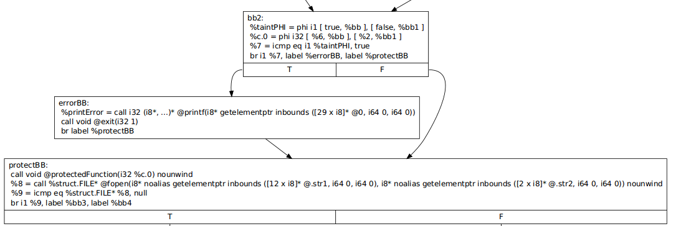
Sinks
Notes:
James – Example of protecting the “protectedFunction” At the callinst we calculate the taint dependencies and OR them together, insert a branch to a new errorBB if any of the taintdependencies were true. Pass dynamically links both a printf function to warn of the problem and exits before the protected function can do harm with the data

Slide 12
Memory
Perform basic tracking of simple memory ops
Stores
Loads
Store(raddr, rvalue)
t_{address} = t_{value}
r4 = Load(r2)
t_{r4} = t_{r2}
Notes:
James – address permanently tainted, works in some cases better than others

Slide 13
Parameter Passing
For each function
Allocate 1 byte of memory per operand
Insert instructions to load taint from memory
For each call instruction
Assign bytes to corresponding function’s memory based on current operands taint
Downside
Doesn’t handle recursive calls
Notes:
James

Slide 14
Evaluation
Compiled bzip2 with taint pass
Achieved 20.37% overhead over compiling without pass
Code expansion
65% in binary code size
87% in LLVM LOC
Notes:
Alex

Slide 15
Difficulties
Resolving taint values at PHI nodes
Parameter Passing
Difficult to parallelize work
%1 = phi %2,…
BB2
BB3
%2 = phi %1,…
Notes:
Alex

Slide 16
Future Work
Fine-Grained Memory Tracking
Bitmap of memory’s address space
Better Function Parameter Passing
Implementation of more policies
Further Testing
Notes:
James

Slide 17
Conclusion
Implementing dynamic taint analysis in LLVM is difficult
Vine has 7 instructions
Performance overhead is acceptable for most applications
Code expansion is reasonable for lightweight applications
DEMO
Notes:
James - Function foo to branch instructions
foo to protected function
tainted.txt to fgets
argv to branch

